Slide 1
Project
Central Bank of North America

Slide 2
Project Objective
Analyse the customer bata of a North America bank and build an interactive dashboard using Tableau . Building a dash board will involve analysing the data and presenting the results using appropriate charts/ graphs.

Slide 3
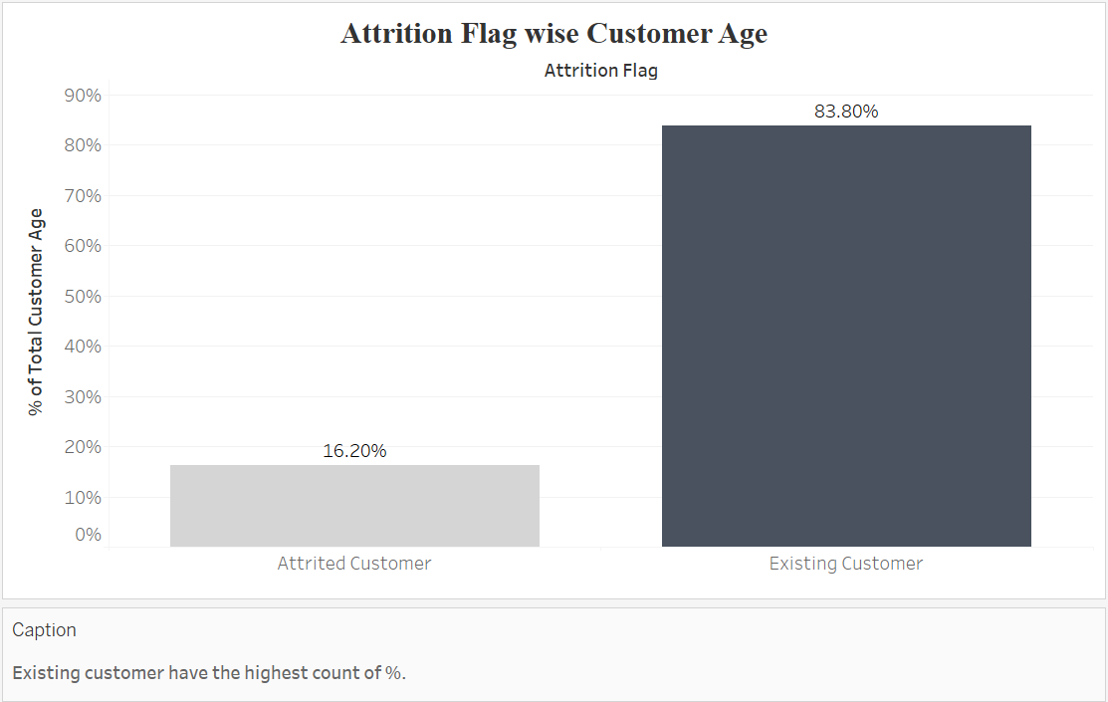
Task 1
Display the percentage of the attired and the existing customers from the data.

Slide 4
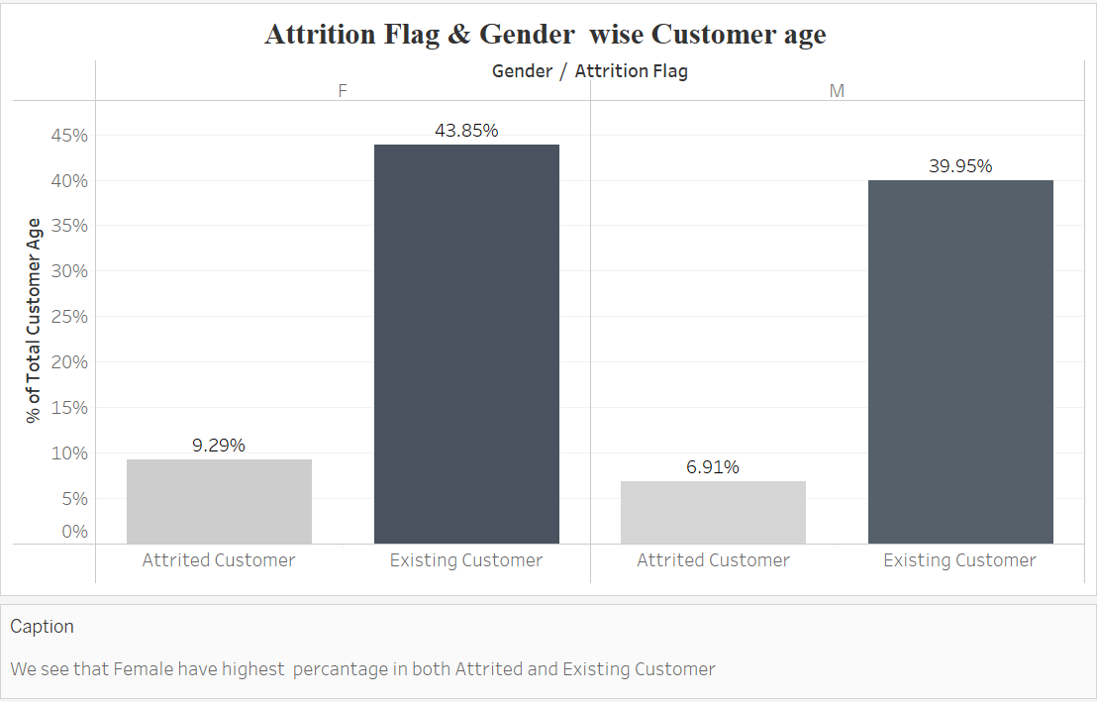
Task 2
Display gender-wise percentage of the attired and the existing customers .

Slide 5
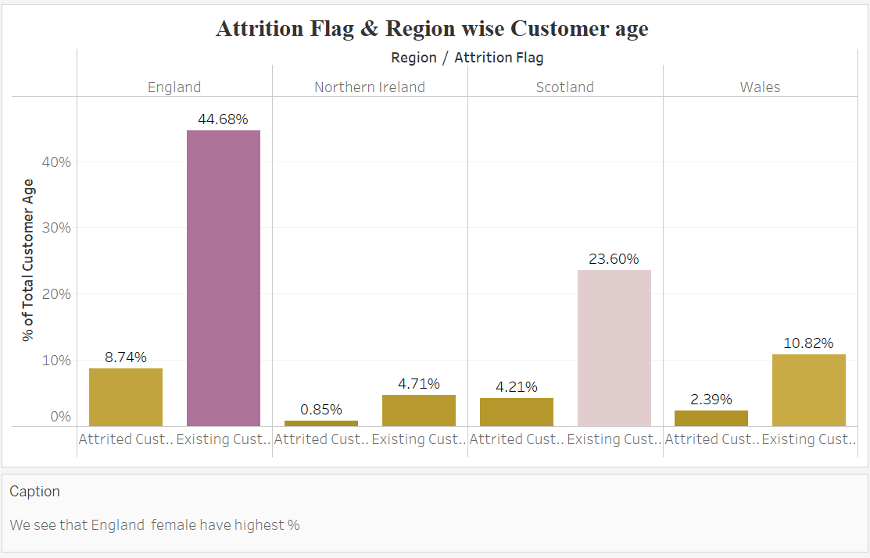
Task 3
Display region-wise percentage of the attired and the existing customers.

Slide 6
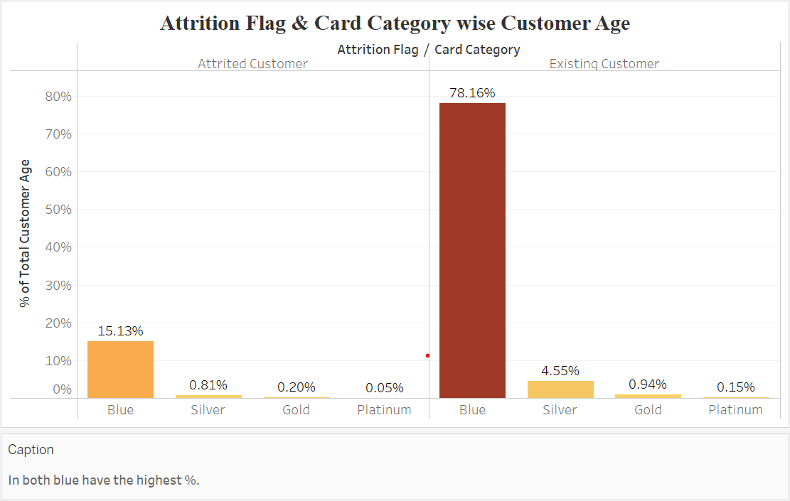
Task 4
Display the percentage of the attired and the existing customers for each card category.

Slide 7
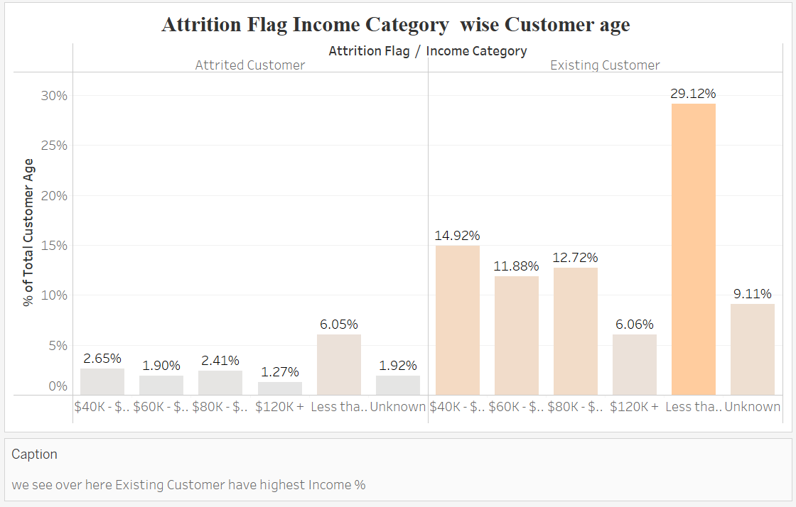
Task 5
Display the percentage of the attired and the existing customers for each income category.

Slide 8
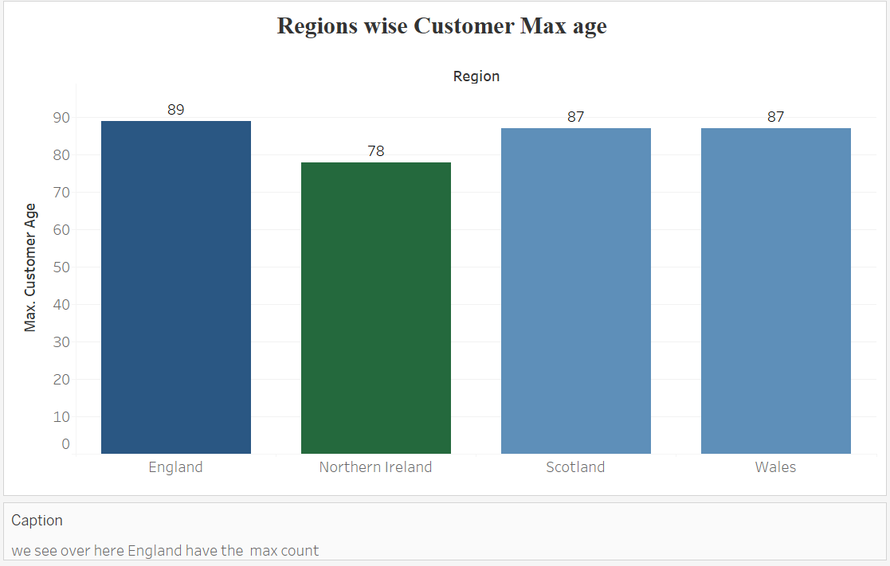
Task 6
Display region-wise count of customers. Identify the region that has the maximum number of customers.

Slide 9
Task 7
Create an interactive dashboard by following the given instructions:
Create a Figma template for the dashboard.
Design the dashboard with the charts created in tasks 1-6.
Apply action filters on the charts created in tasks 1 and 6.

Slide 10
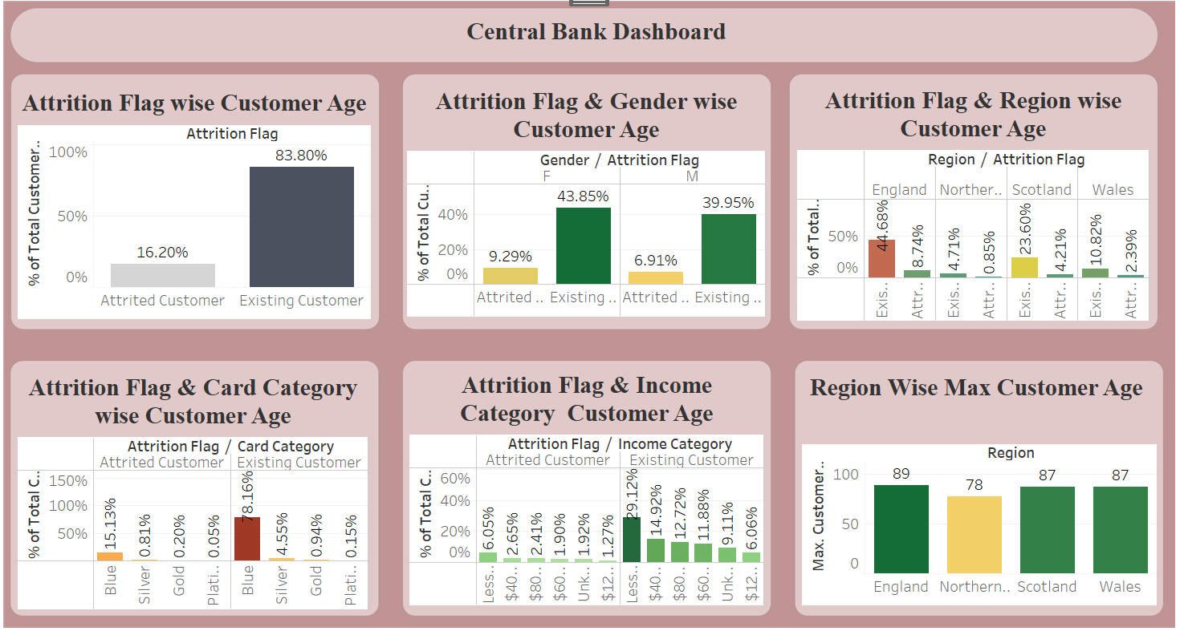

Slide 11
Task 8
Identify 5 to 10 more points of analysis, present them using charts/graphs, and build an interactive dashboard using these charts/graphs. Give proper interpretations by inferring data from the dashboard.

Slide 12
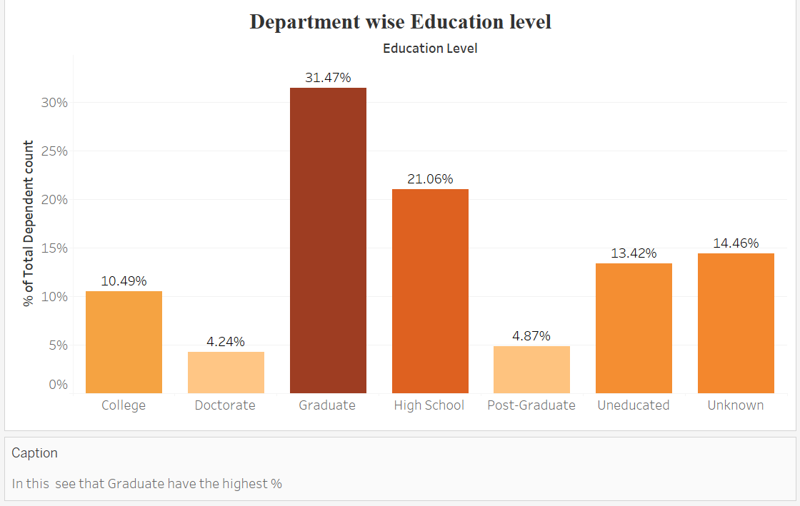

Slide 13
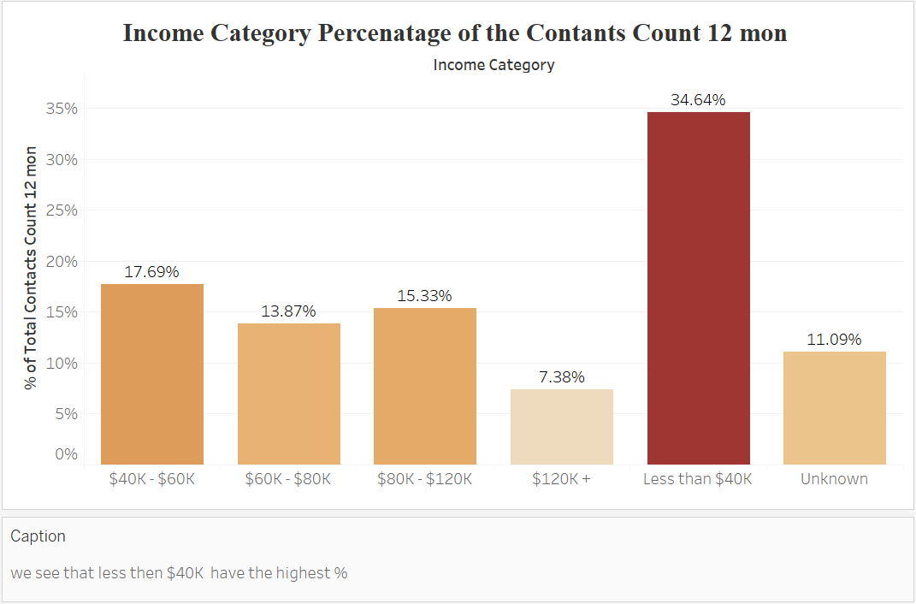

Slide 14
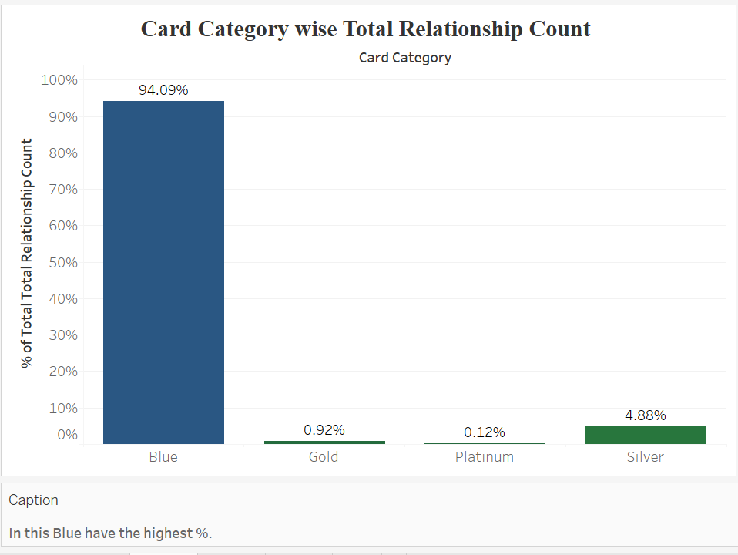

Slide 15
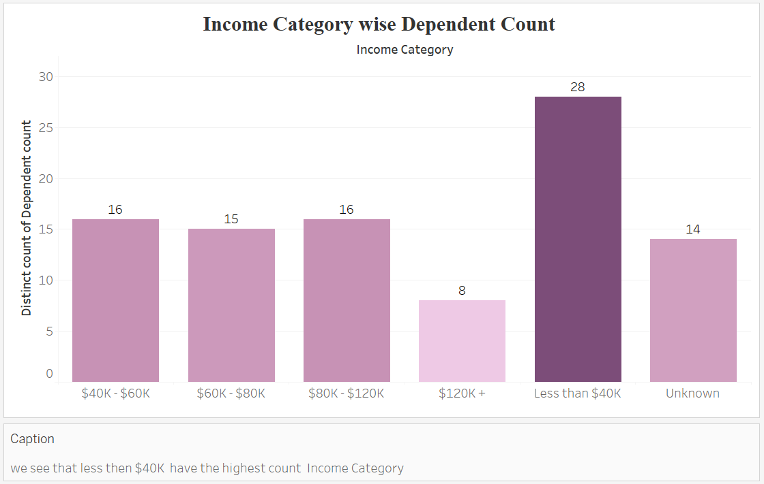

Slide 16
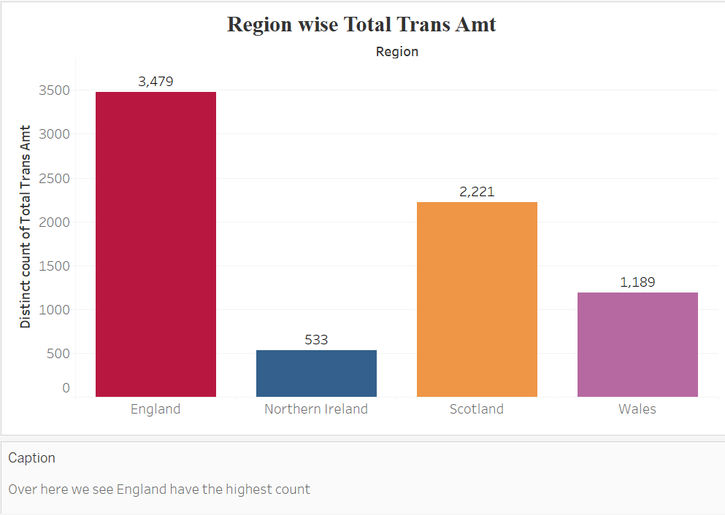

Slide 17
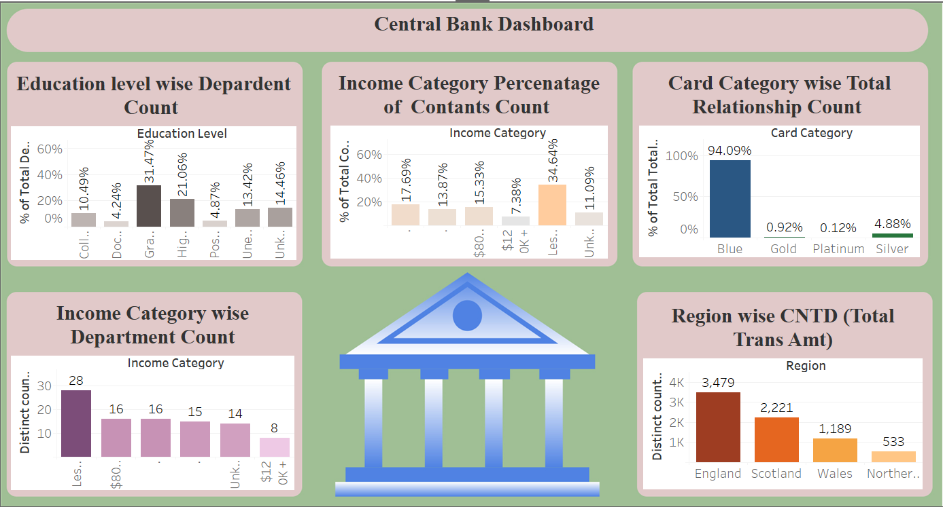

Slide 18
Conclusion
Existing customer have the highest count of %.
In this female have the highest %.
In this England have the highest % .
In both blue have the highest %.
In this less then $ 40 K have the highest %.
England have the highest count .
In this Graduate have the highest count of %..
In this less than $40 K have the highest count .
In this Blue have the highest %.
In this less than $40 K have the highest count .
England have the highest count .

Slide 19


